Slide 1
PEELING THE AGILE ONION
Notes:
My name is Rob Moffat. I am a Java and Javascript software developer working in London. I am building Deutsche Bank’s Symphony Practice. If you don't know, Symphony is a messaging platform that a lot of the banks use for secure, encrypted chat. The chances are that some of you are probably familiar with that in your jobs.
So I guess before I start properly,I want to give some background about why I’m doing this presentation.
I started at DB in April, and I saw that there was this “Agile Month” going on and they were looking for speakers. And I was working on a presentation to give for the London Java Group about Agile and I thought, I should just try out my presentation here. So, I signed up to give this...
But actually, that turned out to be a terrible idea. Looking at it, that presentation really wasn’t going to be completely suitable here, and so what I’ve done is, I’ve kind of car-crashed that presentation, and out of the wreckage, put together something a bit different, which I hope will be a bit more relevant here.
We’ll see.
So, the reason this talk is called “Peeling The Agile Onion” is because I really want to do is get at the heart of what makes agile work.
Hopefully this won’t be an onion that makes us cry. We’ll see.

Slide 2
Personal
Industrial
Notes:
So, what am I going to talk about today.
I’ve been working in banking over the last 20 years or so, and so really, I thought it would be interesting to look at couple of things:
One, I want to look at a “personal” history of agile - how it’s affected me, and what I’ve learned in those 20-odd years.
But I also want to look at the history of Agile within, really, the banking industry, and also look at where that’s going, and how we can expect it to develop.
So hopefully that will be interesting. But I’m also going to try and finish this talk in about 40 minutes because I think probably lots of you will have your own personal views on this, and I think it’d be interesting for us all to just discuss where we think things are heading next.
I want to give you time to react to what I’m saying, because this is all a personal viewpoint, and as we know, those are all flawed in some way.

Slide 3
riskfirst.org
https://github.com/risk-first
Notes:
Now, a third element to what I’m going to cover in my talk is some of the stuff from the London Java Group talk, which was an introduction to Risk First.
This is a website, which you can go and check out after the presentation. I’m going to introduce a few of the concepts from Risk-First today.
Because I really want to explore in this talk the dynamics of agile. That is, try to understand the forces that get us to where we are, and where we’re going. What’s working, and what isn’t. And Risk-First happens to be a fairly useful way to frame that, so I am going to make use of it a bit.
Also, it means I can re-use a whole bunch of the slides I’ve already written, which is handy.

Slide 4
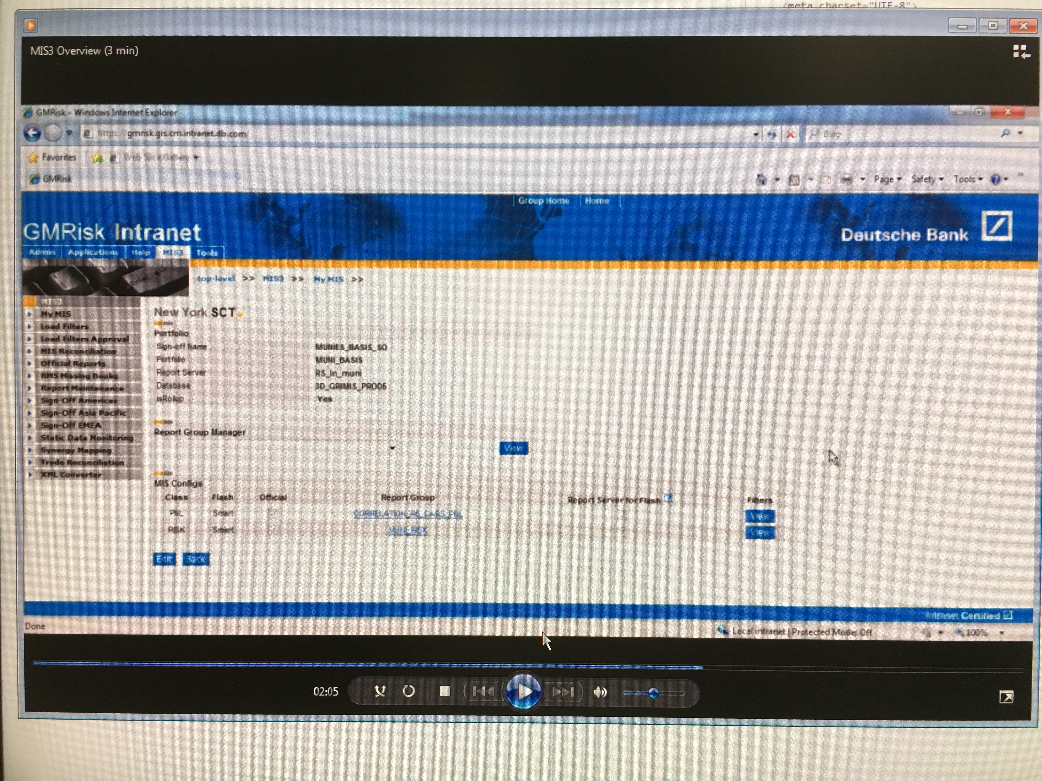
Notes:
Ok, let’s start at the start.
So, this isn’t my first time round at DB. I actually worked here from about 2002 - 2005. Which is a really long time ago.
This was one of the things I built then - it’s called MIS3, and it’s used for signing off end-of-day P&L and risk positions.
It replaced another system, which was called MIS2. So we really came up with the imaginative name there.
Now, I’m mainly showing you this because what the hell! This system is still running somewhere in the bank, and when I started in April I was able to search for this internally and have a nice trip down memory lane.
So actually DB is when I first learnt about “Agile” as a thing. MIS3 had a suite of automated tests. We released every couple of weeks. We met with our users every couple of weeks, we prioritised work.
Also, more because of when it was being done, we didn’t have a project plan, or a release date, or a signed off specification. Because back in 2002, that was just the way we rolled building banking IT! In a way, this was “Accidentally Agile”.
You could just log into production systems and change things. Root access on machines and databases. And so on. I personally managed to fry one of our production databases once.
So, actually, there was a lot of what we call “Operational Risk” back then. Individuals could either deliberately or accidentally mess things up really, really badly.

Slide 5
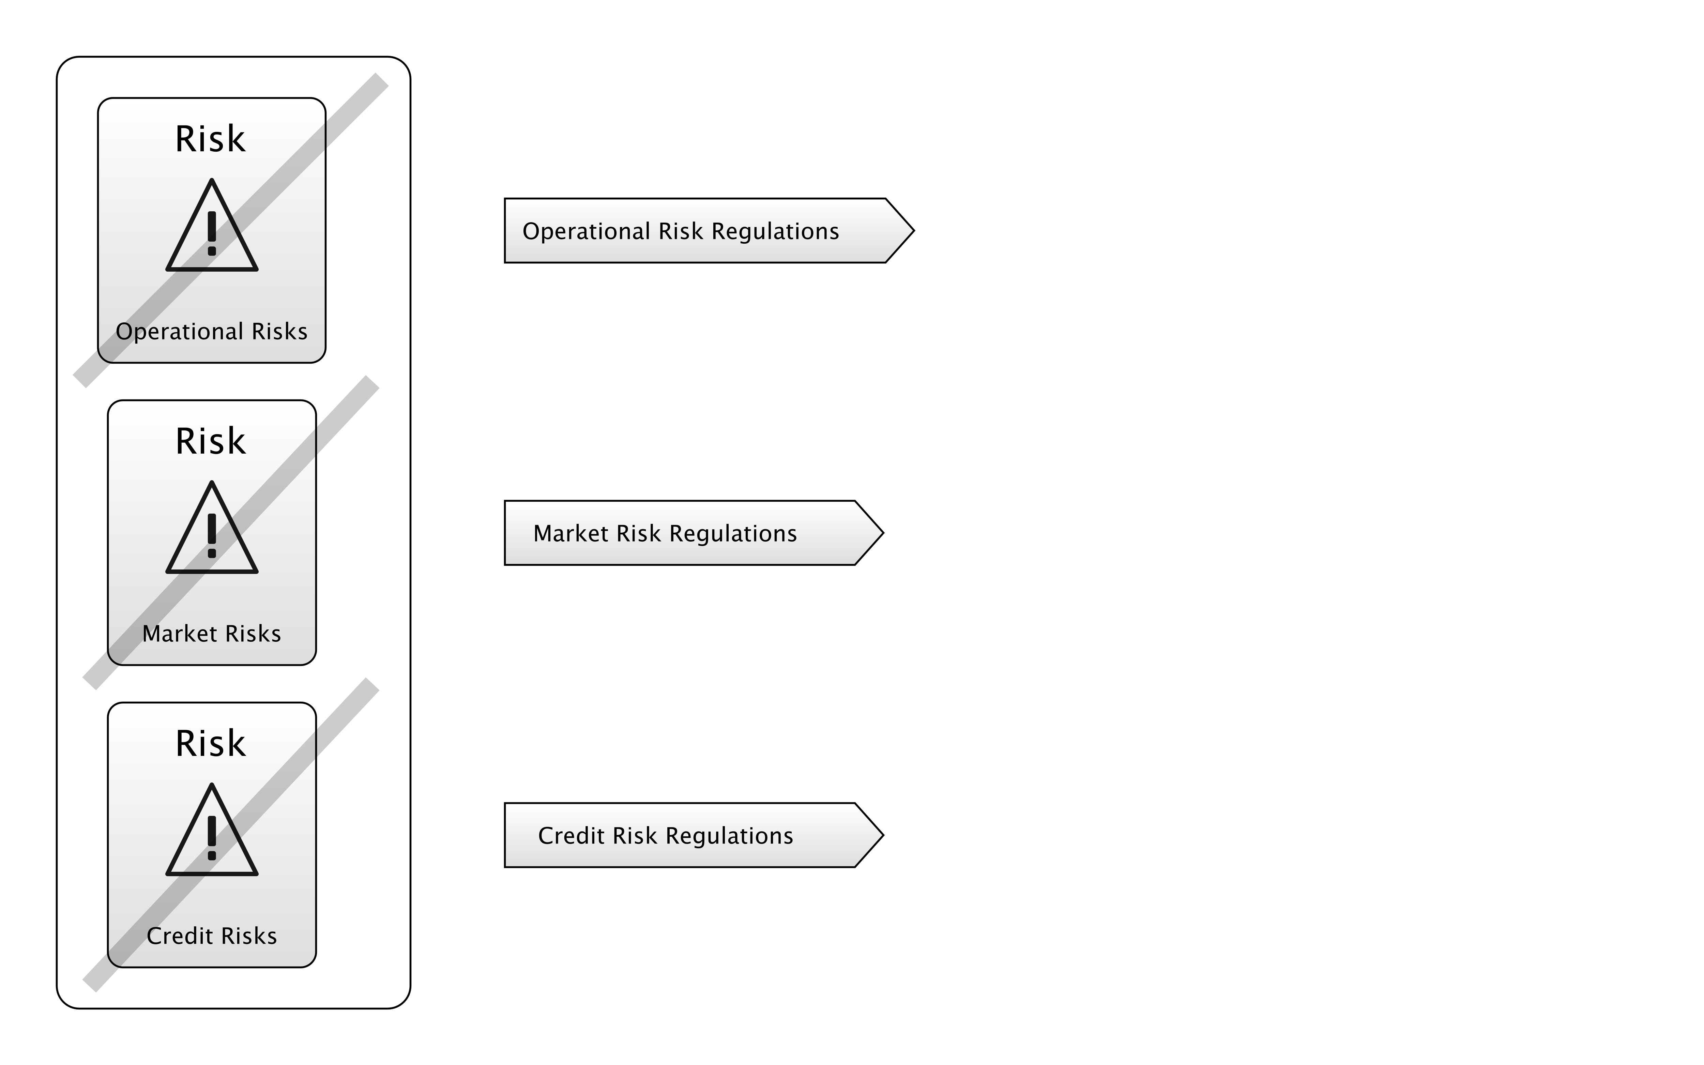
BASEL 2
Notes:
What came in in around 2005 was regulation like Basel 2 which actually addressed this Operational Risk in banks, and forced them to start doing something about it.
As you can see here in the diagram, Basel 2 addressed Operational Risks, Market Risks and Credit Risks, with new regulations for each. Basel 1 had just been about those bottom two, so Operational Risk was a new concern.
Audits started coming in, and break glass accounts, and change requests, and all this stuff.
Which made it harder to do the wrong things, but also made it harder to do the right things.
So, some of those accidentally-agile practices were going to get harder to do. For good reason. Having systems like that was just dangerous.

Slide 6
"THE BASIC PROBLEM OF SOFTWARE DEVELOPMENT IS RISK"
Notes:
Now, it turns out, bankers weren’t the only people thinking about risk.
The quote above is actually the first sentence from Chapter One of a fairly famous book on Software Development.
Does anyone know which one?

Slide 7

Notes:
Ok, who's heard of this book? Who's heard of Kent Beck?
Anyone read it?
Does anyone actually practice XP in their jobs?
This is the first Agile book I read, whilst at Deutsche Bank that first time.
This seemed like a breath of fresh air compared with what I’d learnt at university about software development.

Slide 8
Notes:
Kent had a bunch of ideas in this book, that really deviated from the accepted “norms” of software development, like Pair Programming.
This is a picture of some guys Pair Programming.
Some people love it. A lot of developers grew to hate XP because of this. They didn’t want to share a keyboard and mouse with someone, and work together.
But what is the point of Pair Programming?
What Kent is trying to avoid by enforcing this is Key Person Risk. That is, having individuals on a team who are the only people who know about a thing.
And if they leave or go on holiday, your project is down the toilet.
That’s the idea, anyway: Pair Programming is a risk-management technique. Specifically, trying to address Key Person Risk.

Slide 9
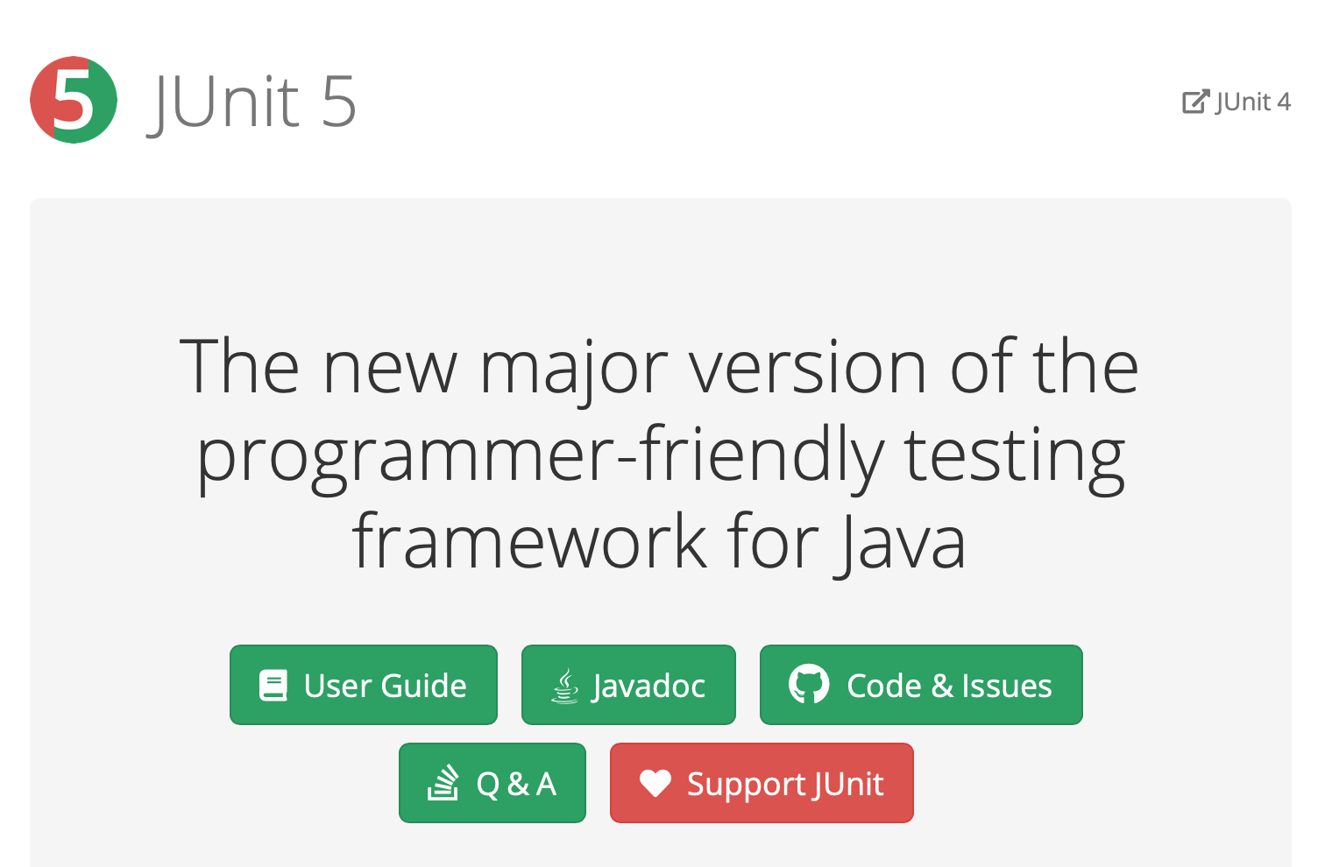
Notes:
Kent Beck also co-invented JUnit. As a Java developer, I use this all the time.
I actually can't imagine coding now without building tests as I go, and having tools to at least understand my coverage.. It just seems so helpful now to have this.
Now, why do we write tests? Why are Unit tests such an integral part of Agile?
I would say, they are managing risk.

Slide 10
Notes:
They are managing a couple of risks: First, you want to test your code before you put it in production. Putting untested code into production is an Operational Risk right there, yeah?
But also, there is a Regression Risk: our code is going to change in the future, we want to change it, and if we have tests, we have some more certainty that when we do change it, we haven’t introduced new bugs.
And, it’s a tradeoff - that’s what’s being shown here. In order to address regression risk, and operational risk, I have to own some extra code in my codebase. So, that’s complexity risk. And building those tests, and maintaining them, that’s going to take some of my schedule up, so there’s a risk to the schedule in writing tests.
Now, if you’re good at Unit Testing, this is a great deal. The trick is to write just enough tests to address the risks on the left. But if you go crazy, you end up turning it into an industry, which blows up those risks on the right.
So, it’s back to this again.

Slide 11
"THE BASIC PROBLEM OF SOFTWARE DEVELOPMENT IS RISK"
Notes:
It seems weird that Kent started his book with this statement, but what people really remember about XP is just Pair Programming, Unit Tests and eating pizza.
I think he was actually on to something really powerful right then and he didn't develop it further.
The reason is, he had these other fish to fry: he'd developed XP which, to him and many other people, was demonstrably better than the way we had been doing software development.
And so his book was just a catalog of all these "better" techniques, and how they could be used together.

Slide 12

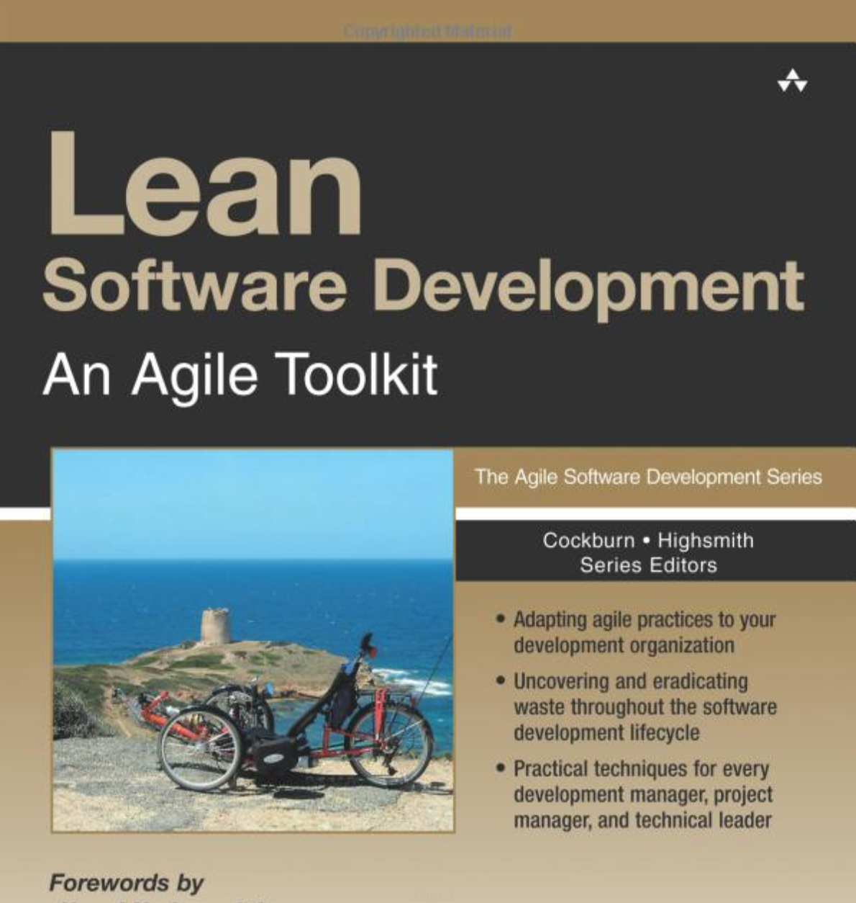
Notes:
These approaches are more popular than XP nowadays.
Who uses Scrum at work? We’re going to talk a bunch about how Scrum has been accepted in Software Development.
Anyone use Lean or Kanban?
Does anyone still use Waterfall?

Slide 13
Notes:
I’m not here to rag on Waterfall.
Sometimes, Waterfall is the right way to go!
We'll dive into that in more detail in a minute, but it feels like collectively, as an industry, or a practice, software development has been on a path of discovery.

Slide 14
"WE ARE UNCOVERING BETTER WAYS OF DEVELOPING SOFTWARE BY DOING IT AND HELPING OTHERS DO IT.”
- Agile Manifesto
Notes:
Waterfall leads to XP and Scrum and Lean and Kanban, lately DevOps and so on.
Exactly as described in the Agile Manifesto.
But, Banking in particular seems to lag on these trends. Now, is there a reason why?
I think there is, and I’m going to explain that.

Slide 15
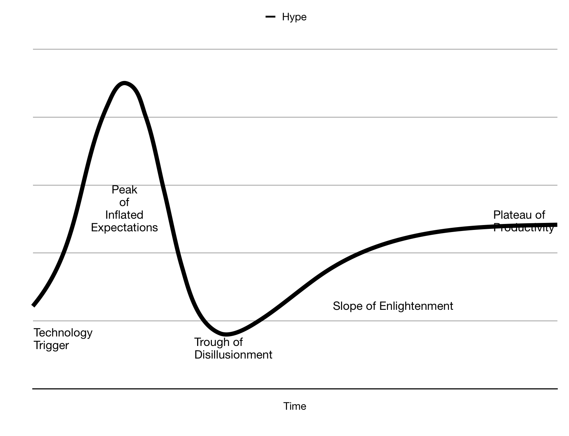
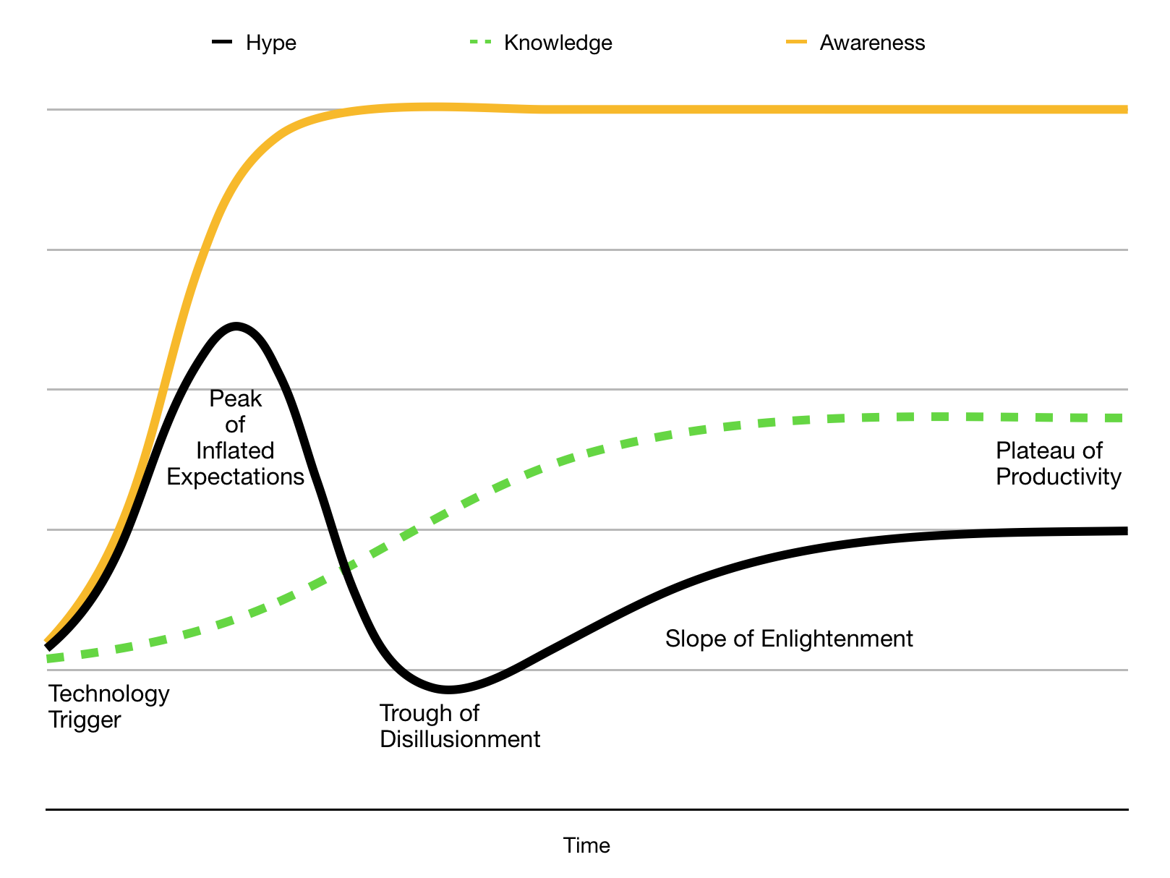
Notes:
Who know’s what this curve is?
It’s called a Hype Cycle.
Basically in a Hype-Cycle we have early adopters of a new idea picking up on it on the left hand side, and using it, and reporting success. And that leads to more awareness.
And more people pile in, using that technology for things that are maybe, not exactly what it was intended for. (The Peter Principle)
And after a while, we end up in this “Peak Of Inflated Expectations” where everyone is raving about a thing, without necessarily knowing all that much about it. So, like Bitcoin a year ago, or fidget spinners two years ago. Everyone was saying they’d cure ADHD for a while. Yeah.
Well anyway, it turns out that the more awareness increases beyond people’s actual knowledge of a thing, the bigger the hype is, and then the worse this crash into the “Trough of Disillusionment”.
Eventually, the knowledge of the thing increases in the population, and people pull out of the hype cycle into the slope of enlightenment and the plateau of productivity, because they know when something is useful, they’re not just jumping on a bandwagon.
They’ve figured out what that thing is useful for, and what it’s not for.
So people like Kent Beck were the far-left adopters on this curve. And, me and other people 20 years ago learning about and trying XP, we were on the left side.
But now, Deutsche Bank has an Agile month. And, it’s taken 20 years for this Hype Cycle to move from “Technology Trigger” to where it is now. And, I think there’s a lot of Agile hype now, so that probably means we are headed towards a trough of disillusionment, at least according to this model.
So, I guess the question is, why has that taken so long in Banking? Why weren’t they earlier on on this adoption curve.

Slide 16
Banking Regulations | XP
Known delivery date | Known priorities
Cooperation across departments | Small team, centrally located
Broadly, well defined expectations | Better for figuring things out as you go
Notes:
I think there are a few reasons.
First, big organisations are always slower to adapt. And, banks are large organisations. This is often because the people in charge already have their ways of doing things. It’s taken 20 years - a whole generation - for those ideas to change.
But I also suspect that it’s partly to do with the 2007 Financial Crisis. Certainly, in the risk departments I worked in, regulations started flying in from all directions.
And, the regulations always had a delivery date.
And, they generally required coordination across a large number of very disparate groups of people.
And, they were generally very clear in what they wanted to see.
I personally felt for a long while that those kinds of projects didn’t really lend themselves to an agile approach.
You were given a bunch of money, and told to make something happen across a large organisation, by a certain date.
You couldn’t put together a small team in a room, you couldn’t apply a process of iterating in two weeks.
So banking (and especially Risk, which I worked in) stuck with Waterfall for far longer than many other industries, I think.

Slide 17
"THE BASIC PROBLEM OF SOFTWARE DEVELOPMENT IS RISK"
Notes:
OK, so all this talk of Financial Crises and Waterfall is a bit tedious. Let’s mix things up a bit and do a quick Risk-First introduction.
When I was at school, I took Economics. We were 17 or 18 years old. And one of the guys just asks:
"What's the point of all this? Surely the markets are just people buying and selling stuff? They don't know about demand curves and price elasticity and all of these things!"
My economics teacher had to take quite a lot of shit actually. We were young and political and pretty annoying teenagers. But he gave a great answer:
"When footballers are playing a match of football, they have an understanding of how the ball works. But they don't need to be good physicists. Nevertheless, physical rules underpin the game they play.”

Slide 18
Notes:
Now, that might be overselling Economics, "the dismal science", as a discipline, comparing it to Physics.
It seems to me that Kent Beck understood that something similar was true in Software.
Risk was that underlying physics of building software.
I’ve come to the same realisation, and I’m going to spend a couple of minutes now trying to persuade you why that’s true.

Slide 19
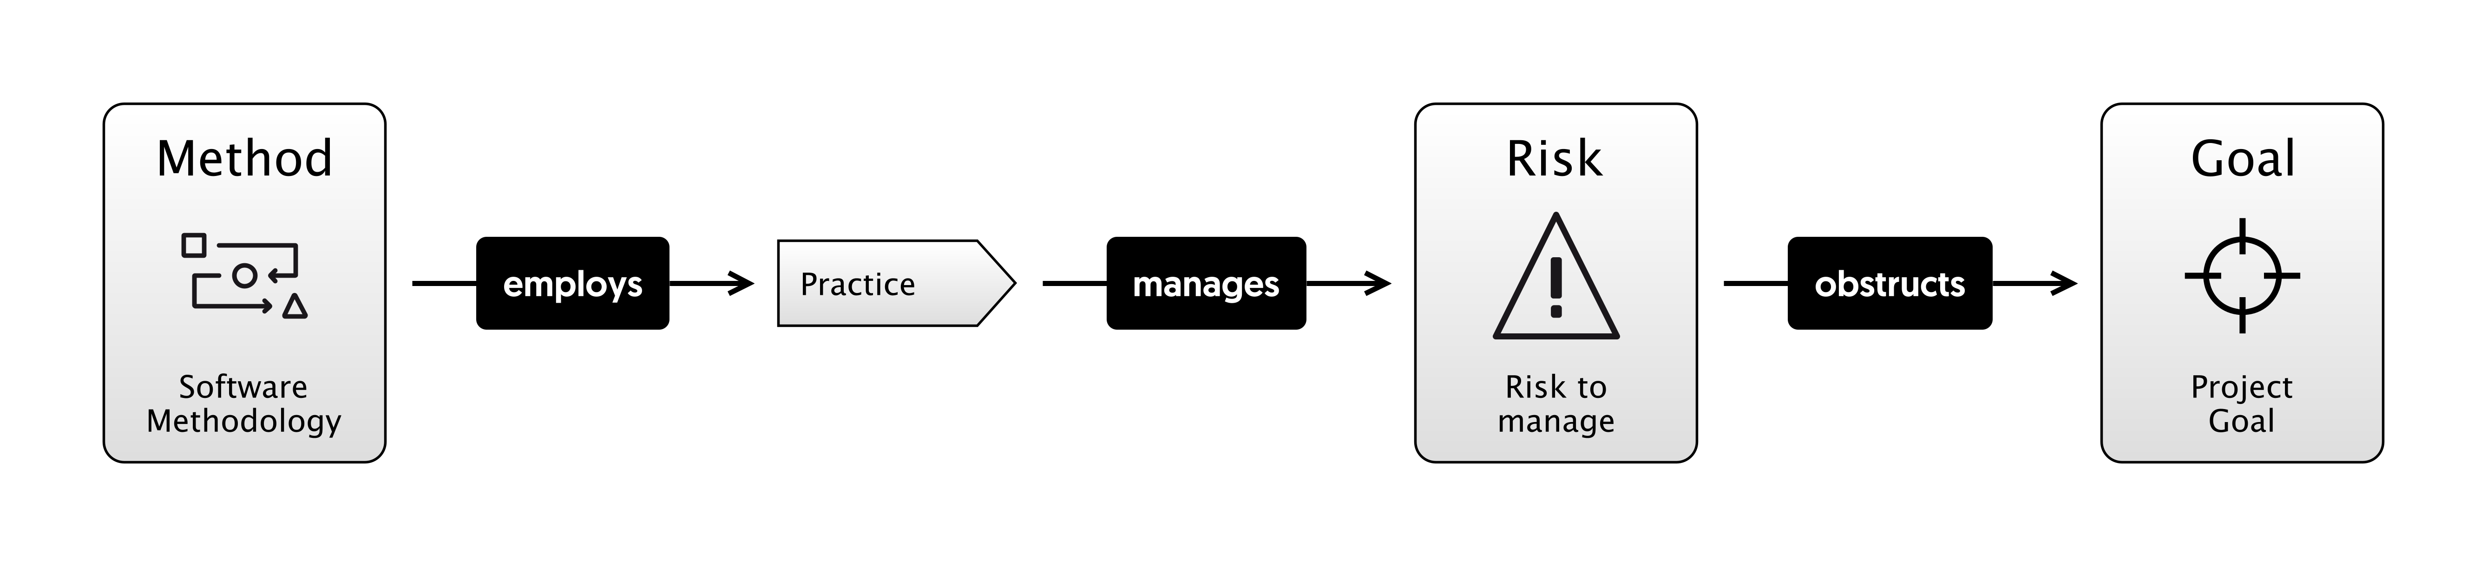
Notes:
That is, methodologies like Scrum, XP, Waterfall are collections of practices like Unit Testing, Standups and so on. And these practices are meant to manage risk.
Risk is the underlying "physics" that we're dealing with.
And risks are all the things that can go wrong on your project, preventing you from hitting the goal, the vision of reality that you wanted.
I am going to try and make that case in various ways, and then we can try to apply that principle in a number of different scenarios and see where it gets us.
You could argue, like a footballer might, that understanding that lower level isn't going to make a jot of difference to how you do the higher level stuff. How do you run a good retro? How do you do estimating? How do you code a feature?
You can know all that stuff separately.
Actually though, I think, like economics, not only that it is useful, but that we're already doing this stuff anyway, we just don't talk about it.

Slide 20
"THE BASIC PROBLEM OF SOFTWARE DEVELOPMENT IS RISK"
Notes:
So, in order to convince you of this statement, I'm first going to try and convince you of some more specific statements.
Let’s start with..

Slide 21
"THE BASIC PROBLEM OF SOFTWARE DEVELOPMENT IS RISK"
RISK
Notes:
So instead of looking at Software Development for a moment, I’m just going to talk about the board game, Risk.
My son Charlie and I love to play risk.

Slide 22
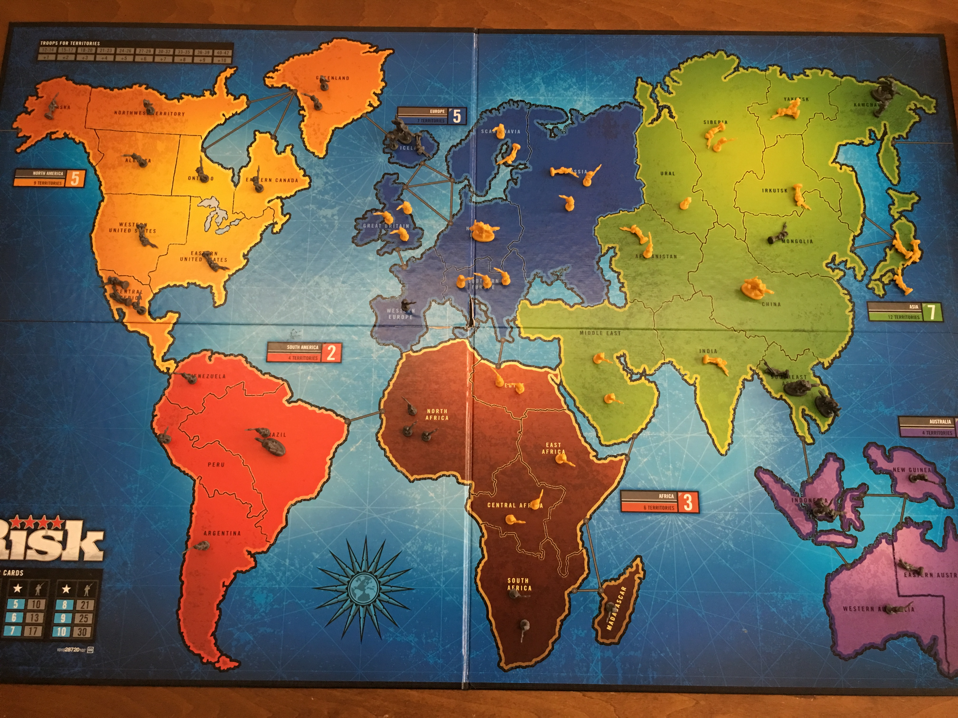
Notes:
This is actually the board from the last time we played. He is Yellow and I am Grey.
If you understand the game risk, you'll know that basically, it's a regressive game.
The person winning has the most land, and they get the most troops.
The only nod at progressive game play (that is, trying to even everyone out) is that attacking is harder than defending.
In this game, I won on the next turn, because I could see Charlie's position was over-extended, and I had a bunch of cards and you get lots of troops for continents - I’ve got 3. North and South America, and Australasia.
Now, Charlie is 12. He plays a good game of chess, but I can beat him at most other things if I want to. Now, we can get into whether or not, as a parent, you should do that another time.
I like playing games with my kids and I feel it's good for them, so I tend to let them win about half the time.
Apart from Chess, where I have to fight for my life.
Why did I know I was going to win? Basically, I have an Internal Model of Risk that's better than his. I could see the danger areas. For example, I knew that by holding Thailand down here, I would prevent him from owning Asia, which would gives him 7 extra troops each go. And by defending Kamchatka up the top I can stop him marching into the US.
But I'm taking risks too: Africa is a huge open back-door, and Charlie could have taken South America and beaten me.
In the same way as Deutsche Bank has Operational Risk, and Market Risk and Credit Risk, I have Africa Risk, and a bit of Kamchatka Risk.
That is, I can identify specific types of risk that’ll cause me to lose the game.

